Slide 1



CYBERSECURITY FUNDAMENTALS AND NETWORK SECURITY
Unit-03
NETWORK SECURITY TECHNOLOGIES
Created by:
Email Address:
Gayathri Gagana
gayathri.g@techdefence.com

Slide 2
CONTENT
Firewalls
Types of firewalls
DMZ Architecture
IDS and IPS
IDS v/s IPS and types
HIDS v/s NIDS
Snort v/s Suricata
VPN and Types

Slide 3
CONTENT
Split Tunneling
Proxy Servers and Types
Network Segmentation
VLAN
Zero Trust Architecture
Identity Centric Security v/s Perimeter Security
Wireless Security
KRACK Concept

Slide 4
FIREWALL
A firewall is a security system designed to prevent unauthorized access to or from a private network. It can be hardware-based, software-based, or a combination of both. Firewalls are an essential part of a network’s security strategy, protecting sensitive data and ensuring the network remains secure from external threats.
Functions of a Firewall:
Traffic Filtering: Firewalls analyze incoming and outgoing packets based on specific rules.
Access Control: They enforce policies that determine which traffic can enter or exit the network.
Monitoring and Logging: Firewalls log traffic data, providing insights into potential threats.
Threat Detection: Advanced firewalls can identify and block malicious activity.

Slide 5
TYPES OF FIREWALLS
Firewalls can be classified into various types based on their operational characteristics. The primary types we will discuss are:
Stateful Firewall
Stateless Firewall
Packet Filtering Firewall
Proxy Firewall
New Generation Firewall

Slide 6
STATEFUL FIREWALL
A stateful firewall tracks the state of active connections and makes decisions based on the context of the traffic, maintaining a table of active sessions.
How It Works:
Connection Tracking: Stateful firewalls maintain a state table that stores information about active connections. This means they can determine whether an incoming packet is part of an established session or a new connection.
Dynamic Rules: When a connection is established, the firewall creates rules dynamically to allow returning traffic. This provides enhanced security since it understands the context of the data packets.

Slide 7
STATEFUL FIREWALL
Advantages:
Improved Security: By keeping track of active sessions, stateful firewalls can identify legitimate traffic more effectively than stateless ones.
Efficiency: They require fewer rules for tracking connections, which can lead to faster processing of packets.
Disadvantages:
Resource Intensive: Stateful firewalls consume more resources (memory and processing power) since they keep track of active sessions.
Complexity: They can be more complex to configure compared to stateless firewalls.

Slide 8
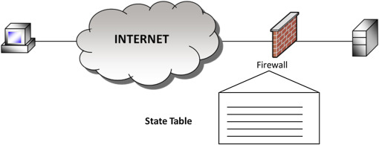
STATEFUL FIREWALL

Slide 9
STATELESS FIREWALL
Stateless firewalls operate without maintaining a connection state, filtering packets solely based on predetermined rules.
How It Works:
Rule-Based Filtering: Each packet is evaluated against a set of rules. If it matches any rule, it is either allowed or denied without regard for any previous packets.
No Context Awareness: Stateless firewalls do not keep track of traffic sessions, treating each packet in isolation.

Slide 10
STATELESS FIREWALL
Advantages:
Simplicity: Easier to configure and manage due to the lack of session tracking.
Performance: Generally faster and less resource-intensive since they do not maintain a state table.
Disadvantages:
Lower Security: Stateless firewalls are less secure than stateful firewalls because they lack the context of active connections, making it easier for malicious packets to bypass security measures.
Limited Functionality: They cannot track or make decisions based on the context of network traffic.

Slide 11
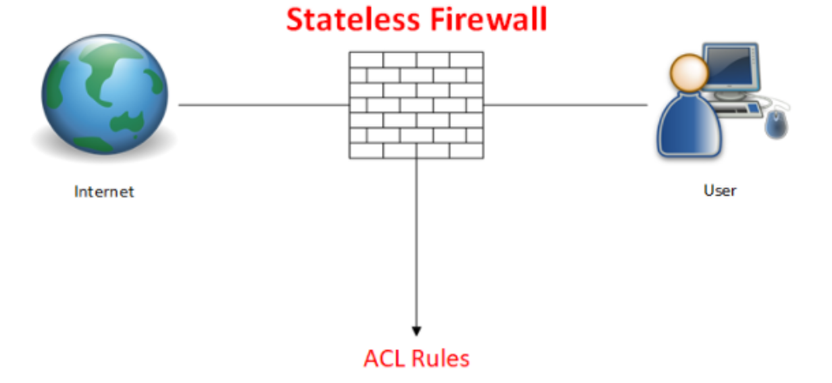
STATELESS FIREWALLS

Slide 12
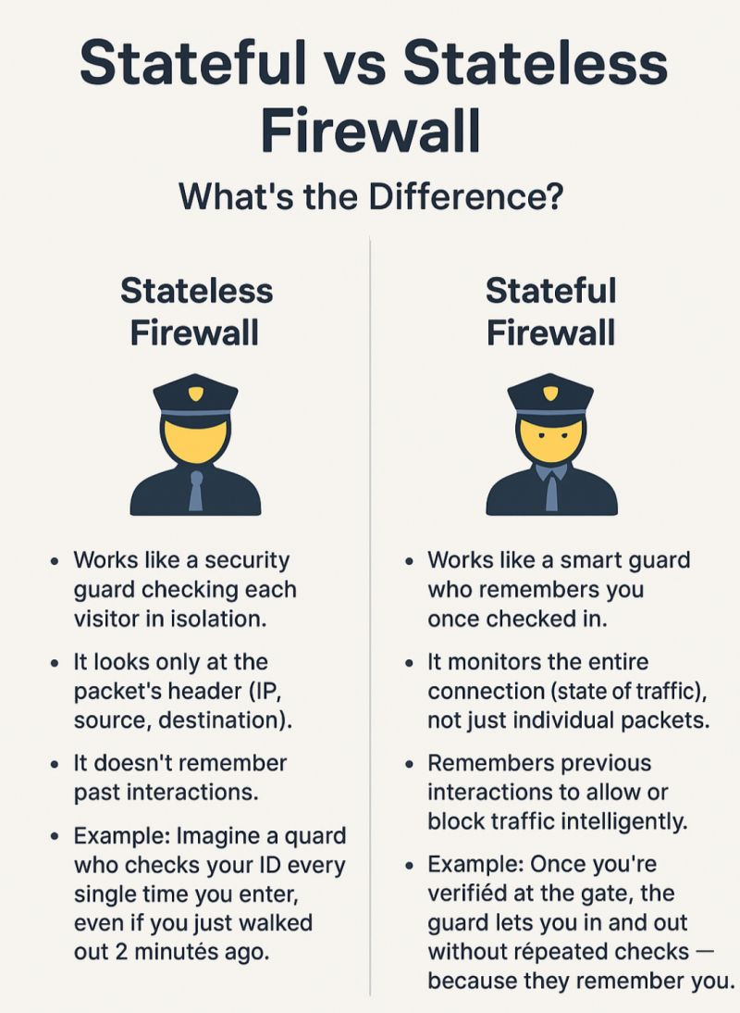
DIFFERENCE BETWEEN STATEFUL & STATELESS

Slide 13
PACKET FILTERING FIREWALL
Packet filtering firewalls inspect packets and allow or block them based on source and destination IP addresses, port numbers, and protocols.
How It Works:
Header Inspection: These firewalls examine packet headers for information such as IP addresses and port numbers.
Decision Making: Based on predefined rules, the firewall will either allow or deny the packet passage. Rules can be based on protocols like TCP, UDP, or ICMP.

Slide 14
PACKET FILTERING FIREWALL
Advantages:
Speed: Packet filtering is usually fast since it operates at a low level and doesn’t require extensive processing.
Resource Efficiency: They consume fewer resources compared to stateful firewalls since they don’t track sessions.
Disadvantages:
Limited Insight: Packet filtering does not analyze the content of the packets, making it less effective against certain types of attacks (e.g., application-layer attacks).
Less Granular Control: More difficult to implement sophisticated filtering policies compared to stateful firewalls.

Slide 15
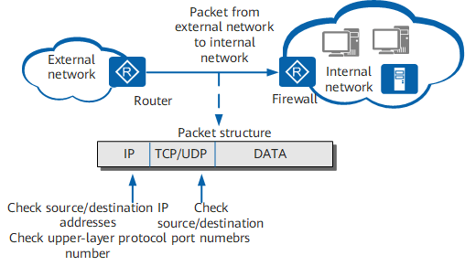
PACKET FILTERING FIREWALL

Slide 16
PROXY FIREWALL
Proxy firewalls act as intermediaries between a client and a server, intercepts all incoming and outgoing traffic and breaks the direct connection between the client and the outside internet (server). Instead of letting the packets pass straight through, the proxy firewall reads the application data, evaluates the request and creates a brand-new connection to fetch the data.
How It Works:
Traffic Interception: When a user makes a request, the proxy firewall intercepts it, forwards it to the destination, and then returns the response to the user. This adds a layer of anonymity and security.
Content Filtering: Proxy firewalls can inspect the content of packets, allowing for more thorough filtering based on application-level data.

Slide 17
PROXY FIREWALL
Advantages:
Enhanced Security: By hiding internal IP addresses, proxy firewalls provide a higher level of security against external attacks.
Content Filtering: They can block malicious content or applications, protecting users from threats.
Disadvantages:
Performance Overhead: Acting as an intermediary can introduce latency, as every request and response must pass through the firewall.
Complex Configuration: Setting up proxy firewalls can be more complicated than other types of firewalls.

Slide 18
NEXT GENERATION FIREWALL
A next-generation firewall (NGFW) is a security appliance that processes network traffic and applies rules to block potentially dangerous traffic. NGFWs evolve and expand upon the capabilities of traditional firewalls. They do all that firewalls do, but more powerfully and with additional features.
An ordinary firewall is like: it blocks or allows data based on where it is going, whether or not it is part of a legitimate network connection, and where it comes from. An NGFW is more like: it inspects data on a deeper level to identify and block threats that may be hidden in normal-seeming traffic.

Slide 19
NEXT GENERATION FIREWALL
NGFWs can do everything that regular firewalls can do. This includes:
Packet filtering: Inspecting each individual packet of data and blocking dangerous or unexpected packets. Packet filtering is explained more below.
Stateful inspection: Looking at packets in context to make sure they are part of a legitimate network connection.
VPN awareness: Firewalls are able to identify encrypted VPN traffic and allow it through.

Slide 20
NEXT GENERATION FIREWALL
NGFWs also add several capabilities that older firewalls do not have. NGFWs use deep packet inspection (DPI) in addition to packet filtering. And according to Gartner, a global research and advisory firm, an NGFW includes:
Application awareness and control
Intrusion prevention
Threat intelligence
Paths for upgrading in order to add future information feeds
Techniques to address evolving security threats

Slide 21
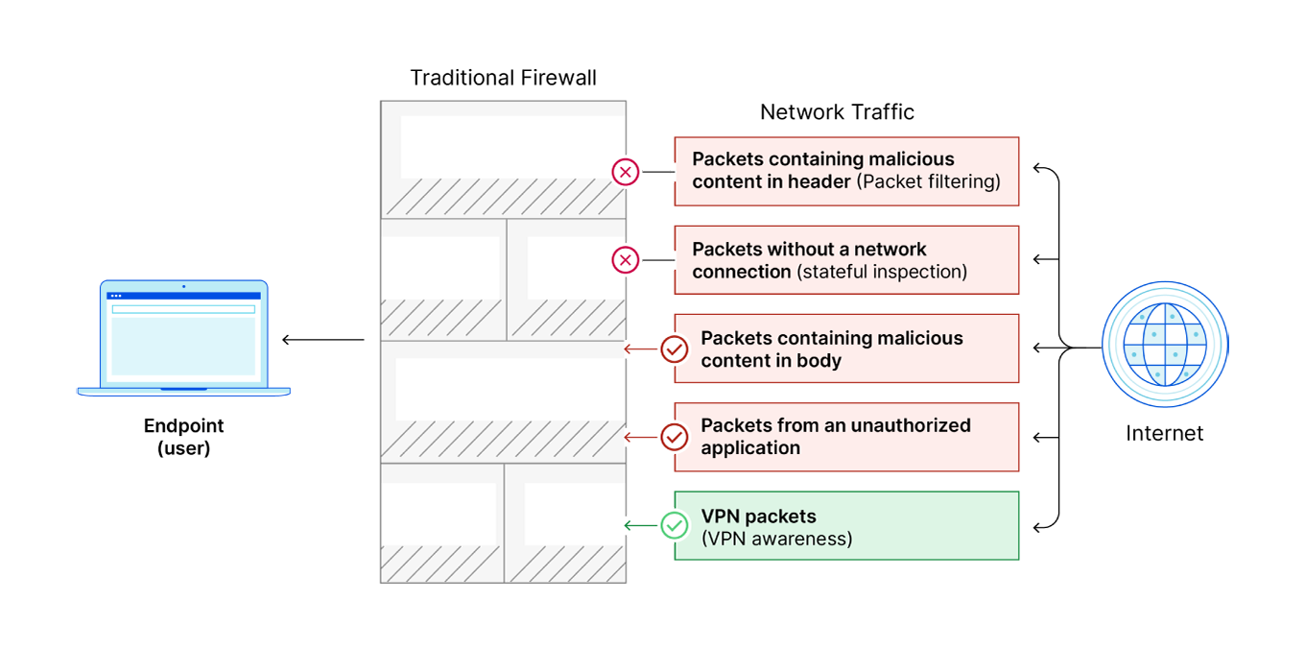
NEXT GENERATION v/s TRADITIONAL FIREWALL

Slide 22
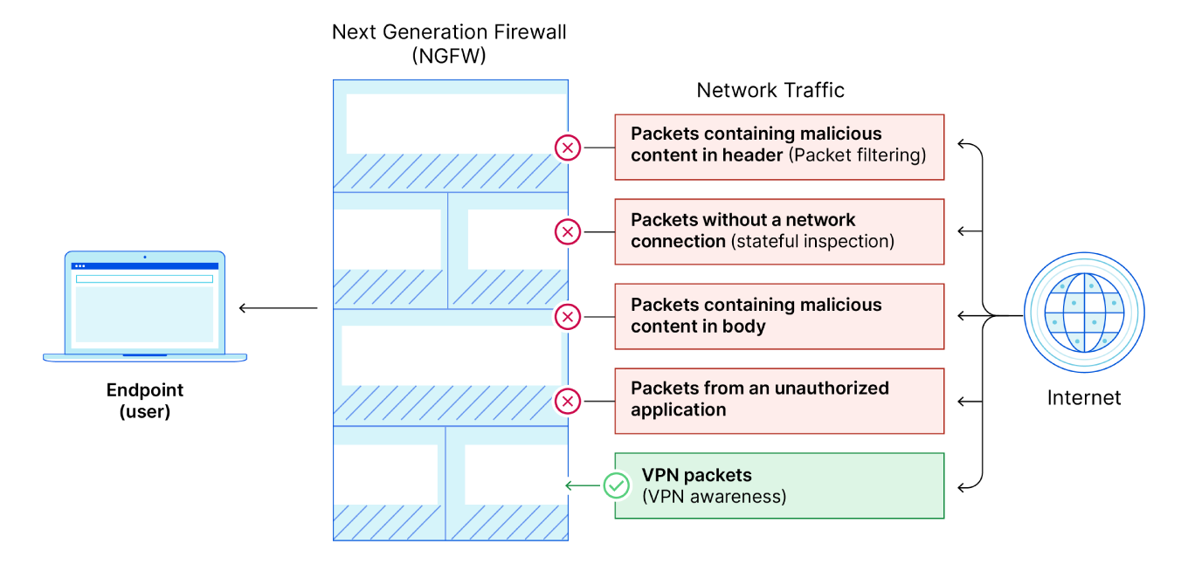
NEXT GENERATION v/s TRADITIONAL FIREWALL

Slide 23
DMZ ARCHITECTURE
A DMZ or demilitarized zone is a perimeter network that protects and adds an extra layer of security to an organization’s internal local-area network from untrusted traffic.
The end goal of a demilitarized zone network is to allow an organization to access untrusted networks, such as the internet, while ensuring its private network or LAN remains secure. Organizations typically store external-facing services and resources, as well as servers for the Domain Name System (DNS), File Transfer Protocol (FTP), mail, proxy, Voice over Internet Protocol (VoIP), and web servers, in the DMZ.
These servers and resources are isolated and given limited access to the LAN to ensure they can be accessed via the internet but the internal LAN cannot. As a result, a DMZ approach makes it more difficult for a hacker to gain direct access to an organization’s data and internal servers via the internet. A company can minimize the vulnerabilities of its Local Area Network, creating an environment safe from threats while also ensuring employees can communicate efficiently and share information directly via a safe connection.

Slide 24
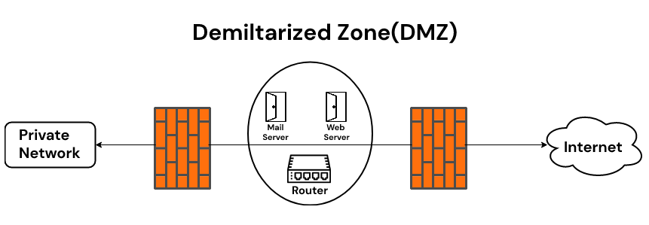
DMZ ARCHITECTURE

Slide 25
BENEFITS OF USING DMZ
A key benefit of a DMZ is that it adds an extra layer of security to your internal network by restricting access to sensitive data and servers. DMZ allows website visitors to subscribe to certain services while providing a buffer to and from your organization's private network.
The primary benefit of using DMZ is a secure network connection.
It provides access control.
It provides protection against Internet Protocol (IP) spoofing.

Slide 26
USES OF DMZ
DMZ networks are an important part of corporate network security for as long as firewalls have existed. They are used for similar reasons. Protect sensitive organizational systems and resources. DMZ networks are commonly used for:
Reduce and control access to the systems by external users
Host corporate resources to make them available to authorized external users.

Slide 27
INTRUSION DETECTION SYSTEM (IDS)
What is an Intrusion Detection System (IDS)?
An Intrusion Detection System (IDS) is a device or software application that monitors network traffic or system activities for malicious actions or policy violations. The primary role of IDS is to detect potential threats and alert administrators to take action. IDS does not prevent attacks directly; instead, it acts as a surveillance system, notifying network administrators of suspicious activities.

Slide 28
INTRUSION DETECTION SYSTEM (IDS)
How IDS Works:
Monitoring: IDS continuously monitors network traffic or system behavior in real time, scanning for anomalies or known malicious signatures.
Detection: It detects potential intrusions by comparing incoming traffic to a set of predefined rules or behavioral patterns.
Alerting: Once a potential threat is identified, the IDS sends alerts to administrators. Alerts may include information about the nature of the attack, the source and destination IPs, and the time of the incident.
Logging: IDS logs details of detected events for future analysis and forensics.

Slide 29
INTRUSION DETECTION SYSTEM (IDS)
Types of IDS:
Signature-Based IDS (SIDS):
Signature-based IDS compares network traffic or system activity to a database of known attack patterns or signatures.
How It Works: When the IDS encounters traffic that matches a known signature, it triggers an alert.
Advantages: Efficient at identifying well-known attacks that have established signatures.
Disadvantages: Cannot detect new, unknown threats (zero-day attacks) that lack pre-established signatures.

Slide 30
INTRUSION DETECTION SYSTEM (IDS)
Anomaly-Based IDS (AIDS):
Anomaly-based IDS analyzes normal network behavior to create a baseline and then identifies deviations from this baseline as potential threats.
How It Works: It continuously monitors traffic patterns, and when an unusual or anomalous behavior occurs, it flags it as suspicious.
Advantages: Can detect novel attacks, including zero-day exploits that have no pre-existing signatures.
Disadvantages: Prone to false positives, as legitimate deviations from normal behavior may trigger alerts.
Other Types of IDS:
Host-based IDS (HIDS): Monitors activities on a specific device or host, such as system files and processes, for suspicious behavior.
Network-based IDS (NIDS): Monitors network traffic for signs of malicious activity, typically deployed at critical points in a network like routers or switches.

Slide 31
INTRUSION DETECTION SYSTEM (IDS)
Advantages of IDS:
Early Warning: Provides early detection of potential intrusions or breaches, allowing security teams to respond quickly.
Visibility: Offers insight into the types of attacks targeting the network, enabling better understanding of threat landscapes.
Passive Monitoring: As IDS does not interfere with network traffic, it does not introduce latency or affect network performance.

Slide 32
INTRUSION DETECTION SYSTEM (IDS)
Disadvantages of IDS:
No Prevention: IDS is limited to detection and alerting, meaning that it cannot stop an attack from occurring.
False Positives: Anomaly-based IDS can generate false alerts, leading to unnecessary investigations or alarm fatigue.
Limited to Known Signatures: Signature-based IDS relies on pre-existing signatures, making it less effective against new or evolving threats.

Slide 33
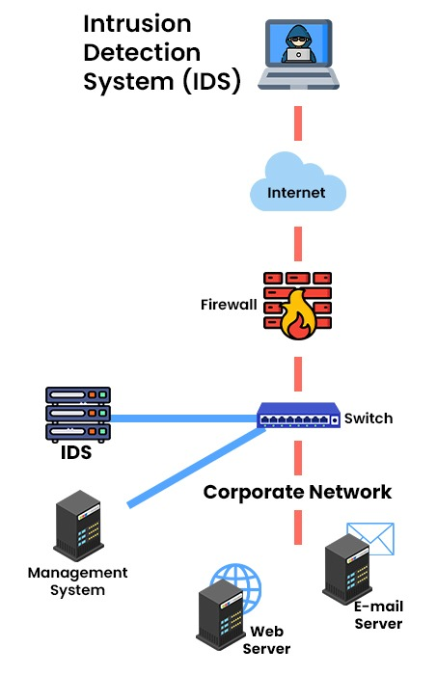
INTRUSION DETECTION SYSTEM (IDS)

Slide 34
INTRUSION PREVENTION SYSTEM (IPS)
What is an Intrusion Prevention System (IPS)?
An Intrusion Prevention System (IPS) is a security tool that actively monitors network traffic and can automatically take action to prevent attacks or suspicious activities in real time. Unlike IDS, which only detects and alerts, IPS can block or prevent threats from reaching their target.

Slide 35
INTRUSION PREVENTION SYSTEM (IPS)
How IPS Works:
Traffic Inspection: IPS sits in-line with network traffic (often between the firewall and the rest of the network), inspecting packets as they pass through.
Detection and Prevention: It detects potential threats using signature-based or anomaly-based techniques, similar to IDS. However, it goes a step further by automatically blocking or dropping malicious packets.
Response: In addition to blocking attacks, IPS can also take other corrective actions such as resetting connections, modifying firewall rules, or triggering alerts.

Slide 36
INTRUSION PREVENTION SYSTEM (IPS)
Types of IPS:
Network-Based IPS (NIPS):
Network-based IPS is deployed at strategic points within the network to monitor traffic entering and leaving the network.
Function: It can prevent threats like Denial of Service (DoS) attacks, worms, or other malware from spreading through the network.
Host-Based IPS (HIPS):
Host-based IPS is installed on individual hosts or devices, monitoring and preventing suspicious activities on that system.
Function: It focuses on protecting the system from attacks like buffer overflows, privilege escalations, or unauthorized access.

Slide 37
INTRUSION PREVENTION SYSTEM (IPS)
Advantages of IPS:
Active Protection: IPS can automatically block attacks in real-time, reducing the risk of successful breaches.
Automated Response: Immediate action is taken to stop threats without waiting for manual intervention.
Granular Control: Allows administrators to fine-tune rules and responses based on network needs.
Disadvantages of IPS:
False Positives: Like IDS, IPS can generate false positives, potentially blocking legitimate traffic or users.
Performance Impact: Since IPS is placed in-line with network traffic, it can introduce latency and affect network performance, especially if improperly configured.
Complex Configuration: Requires careful tuning and regular updates to prevent incorrect blocking or degradation of network service.

Slide 38
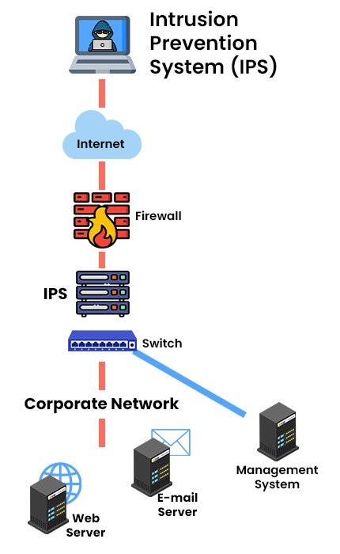
INTRUSION PREVENTION SYSTEM (IPS)

Slide 39
KEY DIFFERENCE BETWEEN IDS & IPS
Feature | Intrusion Detection System (IDS) | Intrusion Prevention System (IPS)
Functionality | Detects and alerts on malicious activities. | Detects, alerts, and blocks malicious activities in real-time.
Action | Does not take action, only provides alerts. | Actively blocks or neutralizes threats to prevent damage.
Response Time | Passive monitoring; alerts after the fact. | Real-time, active prevention of threats.
Use Case | Useful for monitoring and alerting about potential threats. | Suitable for preventing breaches in real-time.
Example | Alerting about traffic spikes during non-burst times. | Blocking malware in real-time based on a known signature.

Slide 40
IDS AND IPS INTEGRATION
Many modern security systems combine the features of IDS and IPS into a single system known as an Intrusion Detection and Prevention System (IDPS). This hybrid solution offers both detection and prevention capabilities, allowing organizations to monitor their networks for suspicious activity while also taking action to block threats as they arise.
Advantages of IDPS:
Comprehensive Security: Provides the benefits of both IDS and IPS, offering visibility into network threats and real-time protection.
Proactive Defense: Organizations can detect and prevent attacks simultaneously, reducing the likelihood of successful breaches.
Reduced Complexity: With IDS and IPS integrated into one system, it simplifies management and monitoring.

Slide 41
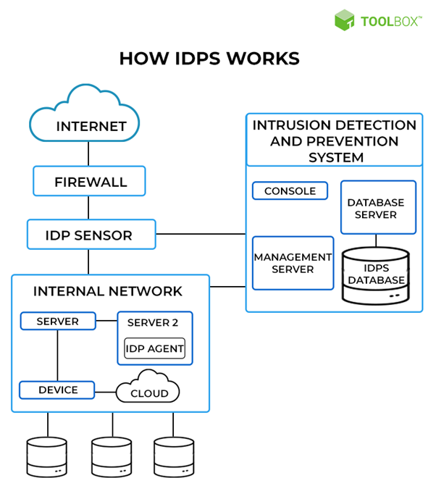
IDS AND IPS INTEGRATION

Slide 42
USE CASES OF IDS & IPS
Intrusion Detection Systems (IDS):
Threat Monitoring: Ideal for organizations that want to monitor threats passively and respond manually.
Compliance and Auditing: Provides a detailed audit trail of network activity, useful for compliance with regulations like GDPR or HIPAA.
Forensic Analysis: Captures network activity for later analysis during incident response.
Intrusion Prevention Systems (IPS):
Proactive Defense: IPS is useful for preventing malware, DDoS attacks, and other threats in real-time.
High-Security Environments: Critical infrastructure, financial institutions, and organizations that cannot tolerate any downtime or breaches benefit from IPS.

Slide 43
HIDS (HOST BASED INTRUSION DETECTION SYSTEM)
This intrusion detection system takes the host as a complete world in itself. It can be a computer (PC) or a server that can serve as a system in itself, analysing and monitoring its internals. It operates by examining the files/data incoming and outgoing from the host it is operating upon. It works by taking a snapshot of the existing file system from the one taken previously and comparing them against each other. If they are the same, the host is safe and devoid of attack whereas changes might point towards a potential attack.

Slide 44
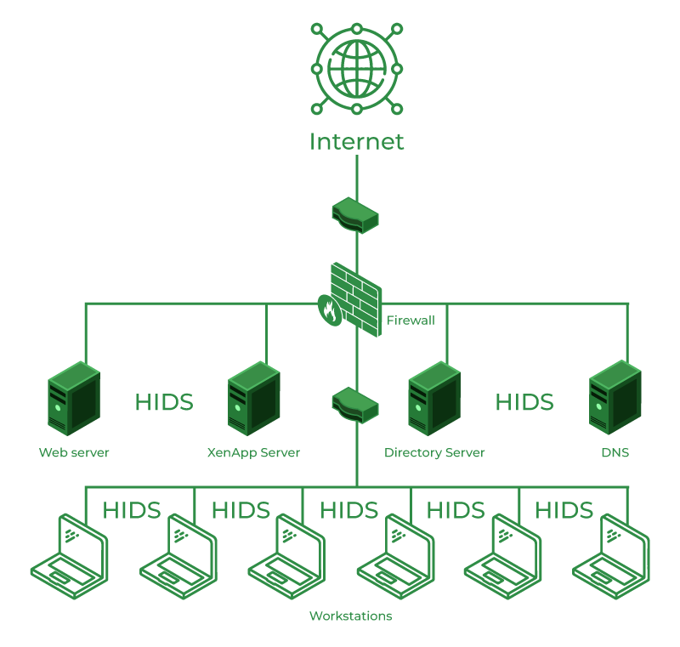
HIDS (HOST BASED INTRUSION DETECTION SYSTEM)

Slide 45
HIDS (HOST BASED INTRUSION DETECTION SYSTEM)
Advantages of HIDS
Analyse what an application does.
Detects the attacks excluded from the network
Disadvantage of HIDS
Excluded from the network
Needs to be installed on every host spot
Passive in nature, so it just informs about the attack without doing anything about it.

Slide 46
NIDS (NETWORK BASED INTRUSION DETECTION SYSTEM)
This intrusion detection system takes charge. Installation points of HIDS and NIDS of the entire network and is capable of operation in mixed and hybrid environments. If anything malicious or unusual is detected on the network or cloud or any other mixed environment it will initiate alerts.

Slide 47
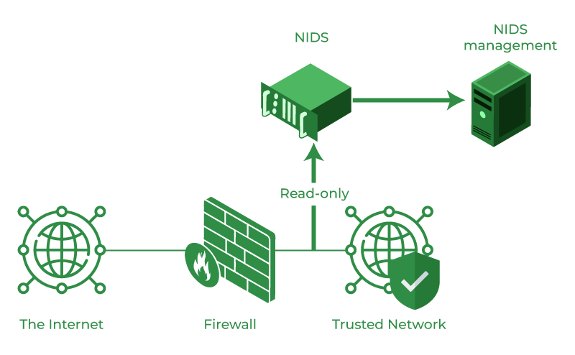
NIDS (NETWORK BASED INTRUSION DETECTION SYSTEM)

Slide 48
NIDS (NETWORK BASED INTRUSION DETECTION SYSTEM)
Advantage of NID
Detect attacks in the entire network
It can use the information collected from attacks on different hosts to detect attacks on a new or fresh host.
Host production/performance remains unaffected.
Disadvantage of NID
It might be slow as compared to the network speed.
Scrutinizing protected channels may possess difficult.
It is also passive in nature.

Slide 49
HIDS v/s NIDS
Categories | HIDS | NIDS
Definition | Host Intrusion Detection System | Network Intrusion Detection System
Type | It doesn't work in real-time | Operates in real-time
Concern | HIDS is related to just a single system, as the name suggests it is only concerned with the threats related to the Host system/computer, | NIDS is concerned with the entire network system, NIDS examines the activities and traffic of all the systems in the network.
Installation Point | HIDS can be installed on each and every computer or server i.e., anything that can serve as a host. | NIDS being concerned with the network is installed at places like routers or servers as these are the main intersection points in the network system

Slide 50
HIDS v/s NIDS
Categories | HIDS | NIDS
Execution Process | HIDS operates by taking the snapshot of the current status of the system and comparing it against some already stored malicious tagged snapshots stored in the database, this clearly shows that there is a delay in its operation and activities | NIDS works in real-time by closely examining the data flow and immediately reporting anything unusual.
Information About Attack | HIDS are more informed about the attacks as they are associated with system files and processes. | As the network is very large making it hard to keep track of the integrating functionalities, they are less informed of the attacks
Ease of Installation | As it needs to be installed on every host, the installation process can be tiresome. | Few installation points make it easier to install NIDS
Response Time | Response time is slow | Fast response time

Slide 51
SIGNATURE BASED IDS
This method relies on predefined patterns (signatures) of known attacks. It compares incoming data to a database of attack signatures.
Easy to implement and effective for detecting known threats.
Cannot detect new or unknown attacks unless their signature is added to the database.
Example: Detecting a specific virus or malware pattern.

Slide 52
ANOMALY BASED IDS
Anomaly-based IDS uses machine learning or statistical models to define what normal behaviour looks like. Any activity that deviates from this norm is flagged as suspicious.
Can detect unknown attacks or behaviours.
High rate of false positives if the model is not fine-tuned.
Example: Detecting abnormal traffic volume or unusual access patterns on a server.

Slide 53
SURICATA
Suricata is an open source network intrusion detection (NIDS) tool developed by the Open Information Security Foundation (OISF).
Suricata can also be used as an intrusion prevention system (IPS) and network security monitoring engine, although this is highly dependent on its installation on your network.
If it is installed as host-based or passive, it works only as an IDS, while if it is installed as an active inline solution, it can also offer IPS functions.
It is known for its high performance, multi-threaded architecture and focus on providing advanced intrusion detection and prevention capabilities.

Slide 54
SURICATA
Suricata works by analysing network traffic, applying predefined rules to identify malicious activity, and alerting administrators of potential risks.
What sets Suricata apart from other NIDS is its multi-threaded architecture, which allows it to efficiently process multiple tasks simultaneously.
This results in faster packet processing and higher throughput compared to single-threaded processing systems.

Slide 55
SNORT
Snort is a popular open source network intrusion detection (NIDS) tool created by Martin Roesch and maintained by Cisco Systems.
Snort has been on the market for almost a decade more and enjoys broad compatibility with various devices, operating systems and third-party tools.
It’s main focus is on rule-based detection and protocol analysis.

Slide 56
SNORT
Snort works by monitoring network traffic and applying predefined rules to detect malicious activity, generating alerts for administrators to take appropriate action.
Snort’s strength lies in its extensive rule set, which can be tailored to meet an organization’s specific security needs.
This adaptability allows Snort to stand out in different environments, offering personalized protection against a wide range of threats.

Slide 57
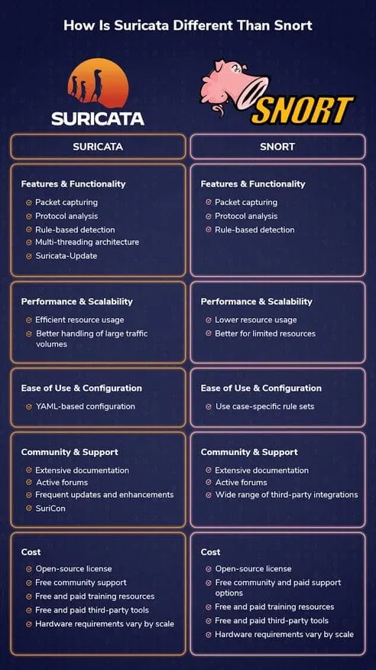
SURICATA v/s SNORT

Slide 58
SURICATA v/s SNORT

Slide 59
VPN (VIRTUAL PRIVATE NETWORK)
A Virtual Private Network (VPN) is a security technology that creates an encrypted tunnel between your device and a VPN server over the internet, so your traffic travels privately and your real IP address is hidden.
Privacy protection: Hides your IP and encrypts traffic, so ISPs, advertisers, and third parties can’t easily monitor your browsing.
Security on public Wi-Fi: Encryption protects logins and personal data on unsafe networks (airports, cafes).
Bypass geo-restrictions: Changes your apparent location by routing through another region’s server, unlocking region-limited sites or services.
Reduce ISP throttling: Since traffic is encrypted, ISPs can’t easily identify specific activities (streaming/gaming) to selectively slow them.
Secure remote access: Let employees connect to internal company resources securely from outside the organization.

Slide 60
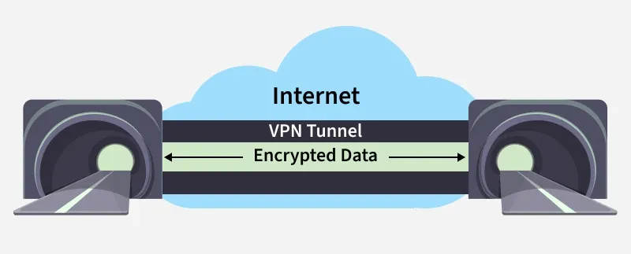
VPN (VIRTUAL PRIVATE NETWORK)

Slide 61
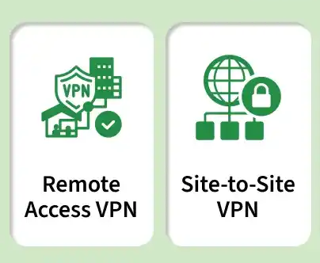
TYPES OF VPN

Slide 62
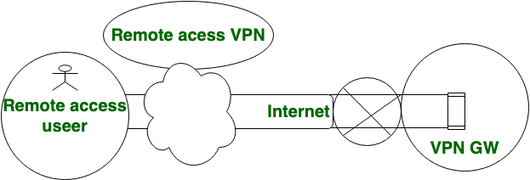
REMOTE ACCESS VPN
In Remote Access VPN, Individual users are connected to the private network and It allows the technique to access the services and resources of that private network remotely. It is most suitable for the business and home users.
In remote access VPN, multiple users are allowed.

Slide 63
REMOTE ACCESS VPN
Advantages
Enables secure access to a private network from a remote location or device.
Allows remote workers to access company resources securely.
Provides a flexible solution that can be accessed from anywhere with an internet connection.
Requires less complex configuration and management than site-to-site VPNs.
Provides a high level of user privacy and data protection.
Disadvantages
May be slower than site-to-site VPN due to the use of encryption and additional network traffic.
May require additional software components to be installed on the user's device.
May require additional user training and support to ensure proper use.

Slide 64
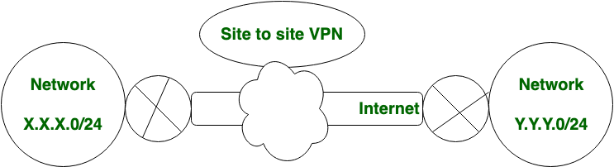
SITE –TO-SITE VPN
Site-to-Site VPN is also known as Router-to-Router VPN. In site-to-site VPN, the IPsec security method is used to create an encrypted tunnel from one customer network to the remote site of the customer.
Multiple users are not allowed in a Site-to-Site VPN.

Slide 65
SITE –TO-SITE VPN
Advantages
Provides a secure connection between two or more networks.
Enables users to access resources located in another location or office.
Encrypts traffic between networks to enhance security.
Offers a cost-effective solution for interconnecting networks.
Provides a high level of network performance and reliability.
Disadvantages
Requires more complex configuration and management than remote access VPNs.
May require additional hardware and software components to implement.

Slide 66
IPSec
IPsec is a group of protocols for securing connections between devices. IPsec helps keep data sent over public networks secure. It is often used to set up VPNs, and it works by encrypting IP packets, along with authenticating the source where the packets come from.
Within the term "IPsec," "IP" stands for "Internet Protocol" and "sec" for "secure." The Internet Protocol is the main routing protocol used on the Internet; it designates where data will go using IP addresses. IPsec is secure because it adds encryption and authentication to this process.

Slide 67
SSL VPN
A secure sockets layer VPN (SSL VPN) enables individual users to access an organization's network, client-server applications, and internal network utilities and directories without the need for specialized software. SSL VPNs provide safe, secure communication via an encrypted connection for all types of devices, regardless of whether access to the network is via the public internet or another secure network.
All traffic between a web browser and an SSL VPN device is encrypted with either the SSL or transport layer security (TLS) protocol. Individual users of the SSL VPN do not have to decide which protocol to use for the VPN to do its job. Instead, the SSL VPN automatically uses the newest, most updated cryptographic protocol that has been installed on the user's browser. Users do not need to worry about updating the protocol on their browser either. Whenever a browser or an operating system (OS) is updated, the newest version of the protocol is updated along with it.

Slide 68
IPSec v/s SSL VPN
IPSec | SSL
Internet protocol security (IPsec) is a set of protocols that provide security for Internet Protocol. | SSL is a secure protocol developed for sending information securely over the Internet.
It Work in Internet Layer of the OSI model. | It Work in Between the transport layer and application layer of the OSI model.
Configuration of IPsec is Complex | Configuration of SSL is Comparatively Simple
IPsec is used to secure a Virtual Private Network. | SSL is used to secure web transactions.

Slide 69
IPSec v/s SSL VPN
IPSec | SSL
Installation process is Vendor Non-Specific | Installation process is Vendor Specific
Changes are required to OS for implementation. NO Changes are required to the application | No changes are required to OS for implementation but Changes are required to application
IPsec resides in the for operating the system space | SSL resides in user space
IPsec has a pre-shared key. | SSL does not have a pre-shared Key.

Slide 70
SPLIT TUNNELING

Slide 71
WHY VPN DOES NOT MAKE YOU ANONYMOUS

Slide 72
PROXY SERVER AND TYPES
A proxy server is an intermediary that sits between your device and the internet, forwarding your requests through another server to improve privacy and control access. It helps mask your real identity while managing how traffic flows.
Hides the user’s IP address from websites and external servers
Filters and controls access to specific websites or content
Can cache data to improve browsing speed and reduce bandwidth use
Adds a layer of security by separating users from direct internet exposure

Slide 73
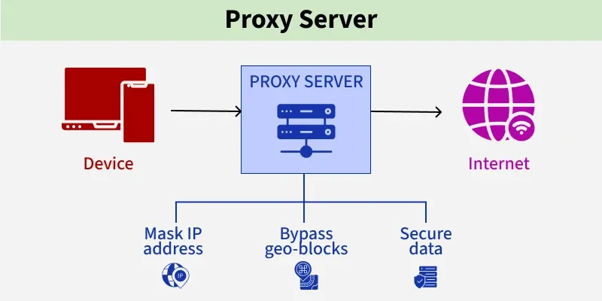
PROXY SERVER AND TYPES

Slide 74
PROXY SERVER AND TYPES
Proxy server processes requests between the client and the internet:
User sends a request to access a website
Request goes to the proxy server instead of directly to the internet
Proxy forwards the request to the target server
Server sends response back to the proxy
Proxy checks security and forwards data to the user

Slide 75
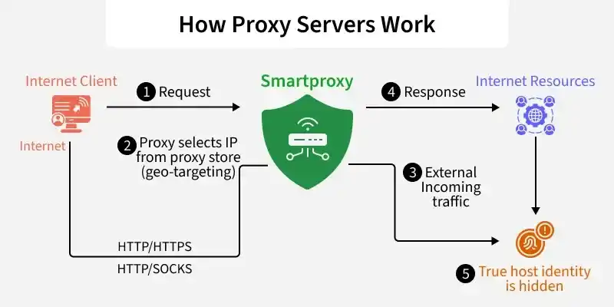
PROXY SERVER AND TYPES

Slide 76
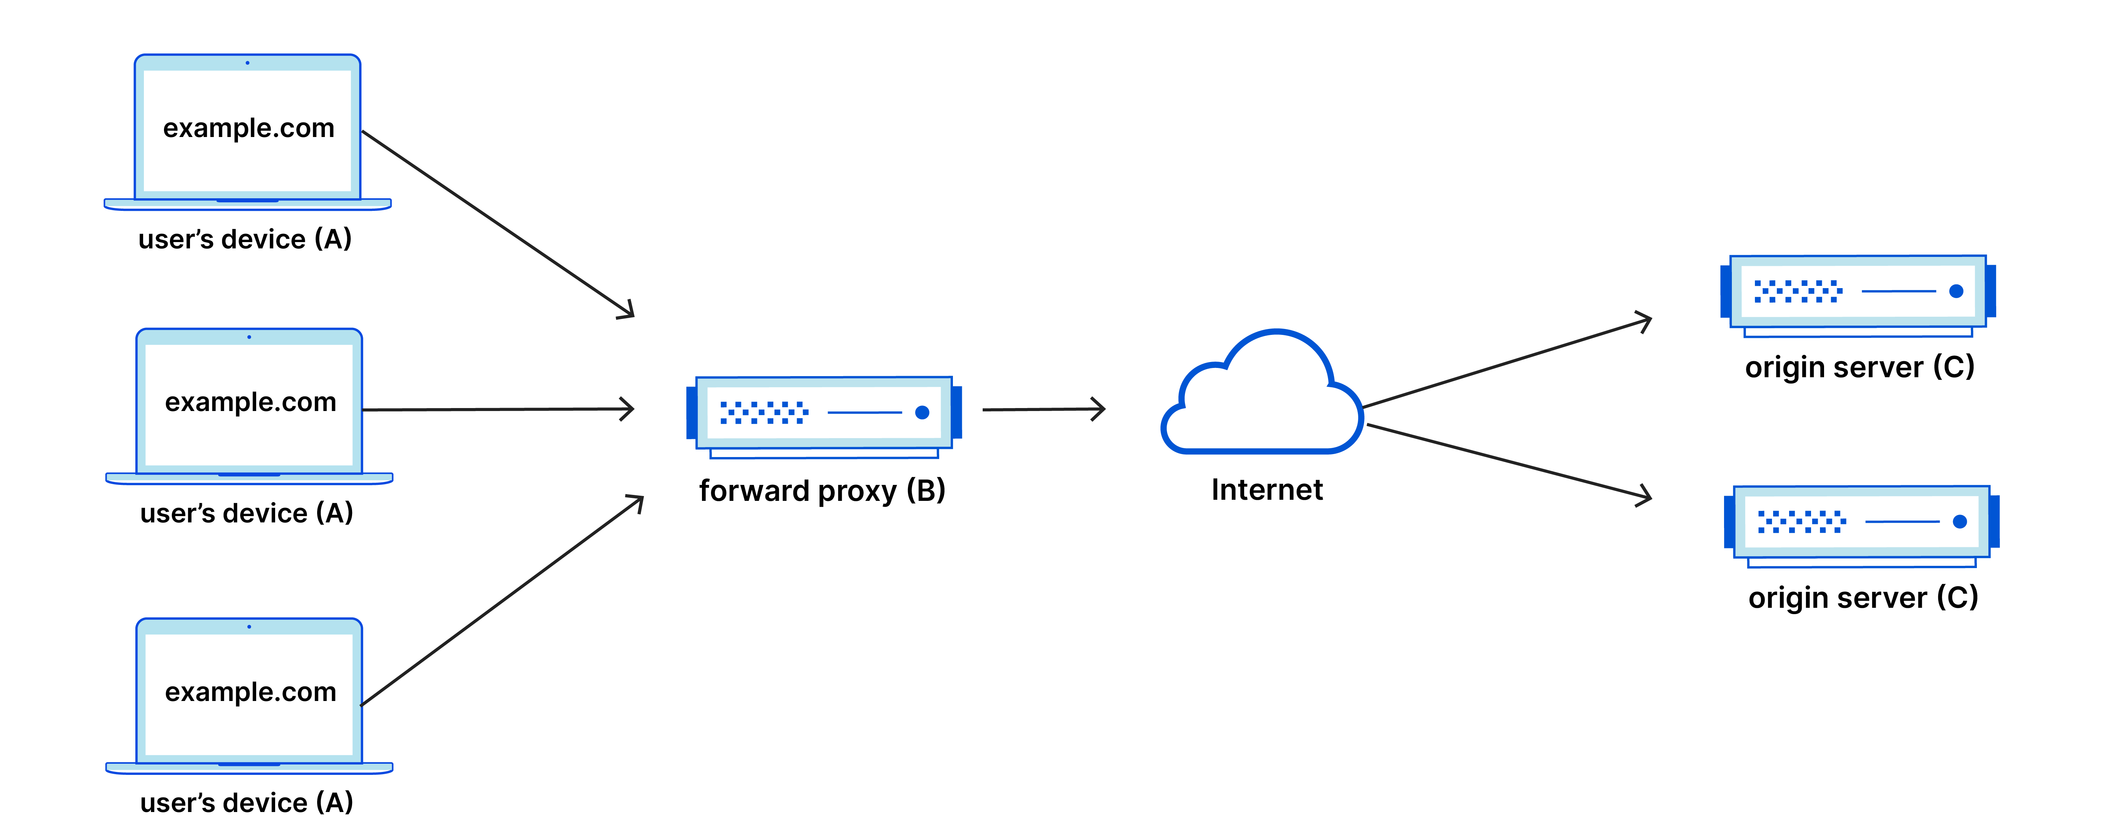
FORWARD PROXY
Sits between users and the internet, hiding the client’s identity.
Filters outgoing traffic
Enhances user privacy
Organizations use it to monitor employee traffic

Slide 77
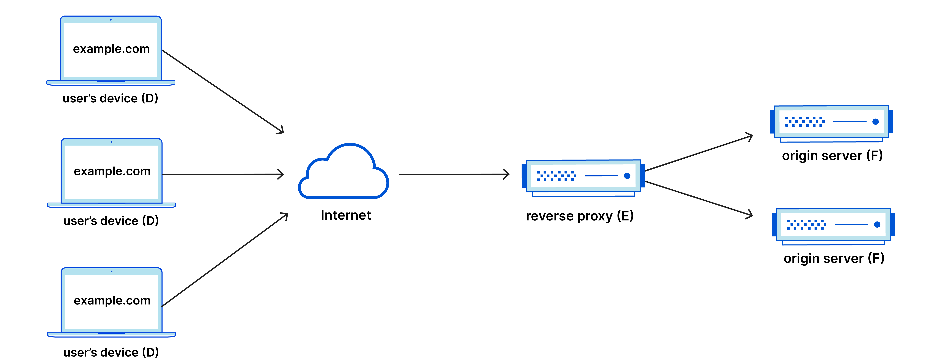
REVERSE PROXY
Sits in front of servers to hide and protect them.
Load balances traffic
Caches content to reduce server load
Improves security and performance

Slide 78
WEB FILTERING PROXY
Handles only HTTP/HTTPS traffic.
Processes URL-based requests
Often used in browsers
Examples: Apache, HAProxy

Slide 79
TRANSPARENT PROXY
Does not hide your IP; often used for caching.
Users may not know it’s running
Common in schools & offices
No anonymity, only filtering

Slide 80
EXPLICIT PROXY
An explicit proxy is configured within the application and is visible to the client.
The client is explicitly configured to use a proxy server in which the browser knows that all requests will go through the proxy.
Unlike Transparent proxy, each desktop must be configured to run explicit proxy.

Slide 81
NETWORK SEGMENTATION
Network segmentation divides a computer network into smaller, isolated segments to control and restrict communication. It enhances security by limiting unauthorized access and containing potential threats within defined boundaries.
Reduces attack surface by isolating critical systems
Limits lateral movement during cyberattacks
Improves traffic control and network performance
Enforces access restrictions using firewalls, routers, or VLANs
Helps contain breaches and protect sensitive data

Slide 82
NETWORK SEGMENTATION
Purpose of Network Segmentation
Network segmentation is used to:
Enhance security by reducing the attack surface.
Improve performance by limiting broadcast traffic and reducing congestion.
Enforce access control by controlling which devices can communicate.
Simplify management and troubleshooting by isolating issues to specific segments.
Support compliance with data protection and industry regulations.
Enable scalability by allowing easy addition of new segments as the organization grows.

Slide 83
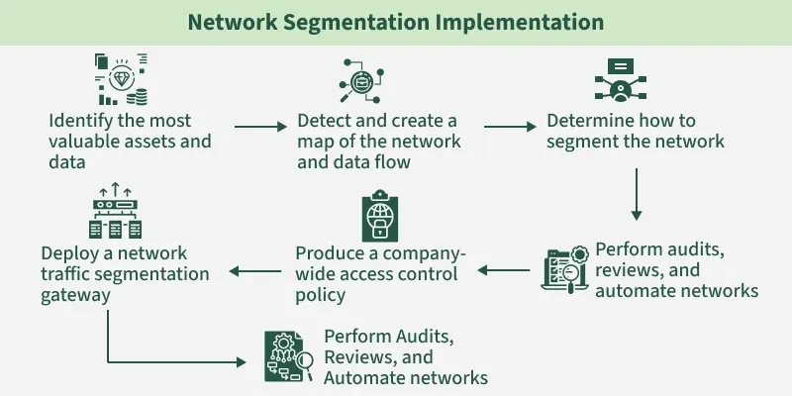
NETWORK SEGMENTATION
Steps to Implement Network Segmentation
Implementing network segmentation involves strategic planning and the use of technologies like VLANs, subnets, firewalls, and access control policies.

Slide 84
NETWORK SEGMENTATION
1.Identify the most valuable assets and data: Determine which systems, applications, and information need the highest protection.
2. Detect and create a map of the network and data flow: Visualize how devices communicate and where data travels across the network.
3. Determine how to segment the network: Decide the segmentation strategy (e.g., VLANs, subnets, firewalls, zones).
4. Perform audits, reviews, and automate networks: Assess current configurations, identify gaps, and use automation for consistency.
5. Produce a company-wide access control policy: Define who can access what, ensuring least-privilege enforcement.
6. Deploy a network traffic segmentation gateway: Implement firewalls, ACLs, and gateways to enforce segmentation rules.
7. Perform ongoing audits, reviews, and automation: Continuously monitor, update, and optimize segmentation as the network evolves.

Slide 85
NETWORK SEGMENTATION
1. Physical Segmentation
Physical Segmentation (or perimeter-based segmentation) separates device groups using dedicated switches, wiring, firewalls, and sometimes individual internet connections.
While it offers strong isolation, it's costly, difficult to scale, and complex to manage. Internal networks often remain flat, so if an attacker bypasses the firewall, they can move laterally with little resistance.
2. Virtual Segmentation
Virtual Segmentation, or logical segmentation, divides a single physical network into multiple isolated virtual segments.
Each segment can have its own security and communication policies. This is commonly implemented using technologies like VLANs (Virtual Local Area Networks).

Slide 86
FLAT NETWORK RISKS
A flat network is a type of network architecture where all the devices in the data centre can reach each other without having to go through intermediary devices like routers.
In a flat network, all devices are linked to a single switch, meaning that all the workstations connected to the flat network are part of the same network segment. Since all devices are connected to a single switch, it becomes one of the easiest network designs to manage. It is also very cost-effective.

Slide 87
VLAN-BASED SEGMENTATION
What is a VLAN? a Virtual LAN that groups devices into a separate logical network on the same switches.
Logical separation: each VLAN is its own broadcast domain and subnet.
Access ports: carry one VLAN to an end device. Trunk ports: carry many VLANs between switches (802.1Q tags).
VLAN-to-VLAN communication: not possible without a router or Layer 3 switch.
Inter-VLAN routing: routing between VLANs through a router or L3 switch.
ACLs and firewall policies: control which traffic is allowed between VLANs.

Slide 88
DMZ-BASED SEGMENTATION
Public-facing services are isolated from internal resources, and traffic between zones is restricted.
Internet
Untrusted
DMZ Web Server
Public-facing
Firewall
Zone rules
Internal DB Server
Protected zone
• Example: the web server in the DMZ may connect to the internal database only on the database port (e.g. TCP 3306); all other DMZ-to-internal traffic is denied.
• The Internet can never reach the database directly.

Slide 89
MICRO-SEGMENTATION
Applies very fine-grained policy down to individual workloads or applications.
Aspect | VLAN segmentation | Micro-segmentation
Granularity | Groups of devices (subnet) | Individual workload or application
Enforcement | Switches, routers, firewalls | Host agents, hypervisor, SDN
Policy basis | IP / VLAN | Identity, context and application
Best for | North-south and zone separation | East-west traffic control
East-west traffic is traffic between servers inside the data centre; controlling it stops attackers moving sideways.

Slide 90
LIMITING LATERAL MOVEMENT
Lateral movement is an attacker moving from one compromised system to others.
Restricting unnecessary connectivity: allow only required flows between segments.
Separating user and server networks: workstations cannot talk to each other or directly to sensitive servers.
Protecting privileged systems: put admin tools and domain controllers in restricted zones.
Limiting administrative protocols: allow SMB, RDP, SSH and WinRM only from jump hosts.
Monitoring east-west traffic: alert on unusual internal connections.
Applying least privilege: minimum access for users, services and devices.

Slide 91
NETWORK SEGMENTATION DESIGN EXAMPLE
A typical enterprise design, with a firewall enforcing rules between all segments.
Segment | Contents | Key rule
User VLAN | Employee PCs | Reach servers on required ports only
Server VLAN | Internal applications and databases | No direct Internet access
Management VLAN | Admin tools, switches, jump host | Reachable only by admins
DMZ | Web, DNS, mail servers | Internet to DMZ only on required ports
Guest Wi-Fi | Visitor devices | Internet only, no internal access

Slide 92
INTRODUCTION TO ZERO TRUST
What is Zero Trust Architecture? a security model that trusts no user, device or network by default, and verifies every request.
Why perimeter security is insufficient: once an attacker is inside the 'trusted' network, they can move freely.
Remote work and cloud: users, apps and data now sit outside the corporate network, so there is no clear perimeter.
Core principles: never trust, always verify; least privilege; assume breach; verify explicitly and continuously.

Slide 93
“NEVER TRUST, ALWAYS VERIFY”
No implicit trust based on network location: being inside the office network grants nothing automatically.
Authenticate every access request: strong identity checks, with MFA.
Authorise based on policy: decisions use rules about who, what, where and when.
Verify device and session context: device health, location and behaviour are checked.
Least-privilege access: users receive only the access needed for the task, for the time needed.

Slide 94
IDENTITY-CENTRIC SECURITY
In Zero Trust, identity is the new perimeter.
User identity: verified through a central identity provider (single sign-on).
Device identity: certificates or management enrolment prove the device is known.
Multi-factor authentication (MFA): two or more proofs, e.g. password plus app code.
Role-based access control (RBAC): access based on job role.
Attribute-based access control (ABAC): access based on attributes such as department, device state, location and time.
Privileged access management (PAM): controls, records and time-limits admin access.

Slide 95
MICRO-SEGMENTATION IN ZERO TRUST
Workload isolation: each application or server is placed in its own protected segment.
Application-specific access: users reach only the application they need, not the whole network.
Restricting lateral movement: a compromised system cannot reach neighbouring ones.
Enforcing policies between resources: every connection between workloads is checked against policy, even inside the data centre.

Slide 96
CONTINUOUS VALIDATION
Trust is re-checked throughout a session, not only at login.
Device Health
Patched? Protected?
Risk-Based Decision
Score the request
Session Monitoring
Watch behaviour
Re-authentication
When risk rises
Respond to Change
Restrict or end session
• Example: a user logs in from a new country mid-session, so the system asks for MFA again or blocks access.

Slide 97
ZERO TRUST VS PERIMETER SECURITY
Zero Trust moves protection from the network edge to every resource.
Feature | Traditional perimeter | Zero Trust
Trust model | Often trusts the internal network more | No implicit trust
Main focus | Network boundary | Identity, device and resource
Access | Often based on network location | Based on identity and policy
Verification | May occur mainly at entry | Ongoing and context-aware
Segmentation | May be limited to network zones | Can extend to individual resources

Slide 98
ZERO TRUST IMPLEMENTATION EXAMPLE
A user requests access to an internal application.
Request
User asks for the app
Identity + MFA
Verified
Device Check
Compliant?
Policy Evaluation
Allowed?
Least Access
Only what is needed
Monitor
Reassess if risk changes
• If any check fails, access is denied or limited, for example a non-compliant device gets no access or read-only access.

Slide 99
INTRODUCTION TO WIRELESS SECURITY
Wireless LAN basics: devices connect to the network by radio through access points (APs).
SSID: the network name broadcast by an AP; hiding it is not real security.
Authentication and encryption: authentication proves who may join; encryption protects data over the air.
Common Wi-Fi risks: weak or shared passwords, open networks, rogue access points, eavesdropping, evil twins and deauthentication attacks.

Slide 100
WPA2 SECURITY
WPA2-Personal (PSK): one shared passphrase for everyone; common at home and small offices.
WPA2-Enterprise (802.1X): each user logs in with their own credentials via a RADIUS server (EAP).
AES-CCMP: the strong encryption and integrity method used by WPA2.
Authentication and encryption: a 4-way handshake creates the session keys.
Security limitations: a captured handshake can be attacked offline to guess weak passphrases; management frames are unprotected by default; KRACK weakness.

Slide 101
WPA3 SECURITY
WPA3-Personal: replaces the shared-key handshake with a stronger method.
SAE (Simultaneous Authentication of Equals): a password-based key exchange where each session key is unique.
Protection against offline guessing: a captured handshake cannot be attacked offline, and online guesses are limited.
Protected Management Frames (PMF): protect management frames such as deauthentication.
WPA3-Enterprise: stronger cryptography, with an optional 192-bit security mode.

Slide 102
WPA2 VS WPA3
WPA3 improves password protection and management frame security.
Feature | WPA2 | WPA3
Personal authentication | Commonly pre-shared key | SAE
Password-guessing protection | Depends on configuration and attack conditions | Improved resistance to offline guessing
Management-frame protection | Optional in many deployments | Required for WPA3 certification
Security | Strong when configured properly | Stronger when supported and correctly configured

Slide 103
EVIL TWIN ATTACKS
What is an evil twin? a fake access point that copies the name of a real one so users connect to it.
Rogue access points: unauthorised APs, either attacker-owned or plugged in by staff.
Fake Wi-Fi hotspots: free-Wi-Fi look-alikes in cafes, airports and hotels.
Credential theft and traffic interception: the attacker sees traffic or shows a fake login page.
Detection: wireless IDS / controller alerts on duplicate SSIDs, unknown BSSIDs and signal anomalies.
Prevention: WPA2/WPA3-Enterprise with certificate validation, VPN on public Wi-Fi, HTTPS, user awareness.

Slide 104
DEAUTHENTICATION ATTACKS
Purpose of deauthentication frames: normally tell a client to disconnect from an AP.
Attack: in older Wi-Fi, these frames are unauthenticated, so an attacker can forge them.
Disconnecting wireless clients: forced to leave repeatedly, causing denial of service.
Rogue-network scenarios: clients reconnect to an evil twin, or the handshake is captured for cracking.
Role of PMF: Protected Management Frames make forged deauthentication frames ineffective.
Defensive monitoring: wireless IDS detects bursts of deauth frames.

Slide 105
KRACK ATTACK CONCEPT
KRACK (Key Reinstallation Attack, 2017) targets the WPA2 4-way handshake.
4-Way Handshake
Client and AP agree keys
Message 3 Replayed
Attacker resends it
Key Reinstalled
Nonce counter reset
Keystream Reused
Encryption weakened
Traffic Exposed
Decrypt or alter
• Impact: potential loss of confidentiality and integrity of traffic. Mitigation: patch clients and APs, prefer HTTPS/VPN, and use WPA3 where supported.

Slide 106
SECURING WIRELESS NETWORKS
Use WPA3 where supported (WPA2 with AES where not).
Use strong, unique passphrases and change them periodically.
Prefer WPA2-Enterprise / WPA3-Enterprise in managed environments.
Update access point firmware regularly.
Disable insecure legacy protocols such as WEP, WPA/TKIP and WPS.
Use guest network isolation; enable Protected Management Frames.
Monitor for rogue access points and avoid default administrator credentials.

Slide 107
WIRELESS SECURITY ASSESSMENT WORKFLOW
A structured approach to reviewing a wireless environment (only on networks you are authorized to test).
Identify Access Points
List all APs / SSIDs
Verify Encryption
WPA2 / WPA3?
Review Configuration
Passwords, firmware, PMF
Check Rogue APs
Unknown devices
Validate Segmentation
Guest vs internal
Document Findings
Risks and fixes
• Finish with a report that lists findings, risk level and recommended fixes.

Slide 108


